Slide 1
Towards a Blend of Machine Learning and Microeconomics
Michael Jordan
University of California, Berkeley

Slide 2
A Personal View on “Machine Learning”: It is the Emergence of a New Engineering Field
Cf. chemical engineering in the 40s and 50s
  built on chemistry, fluid mechanics, etc
  driven by the possibility of building chemical factories
  new concepts and mathematical principles were needed
Cf. electrical engineering at the turn of the last century
  built on electromagnetism, optics, etc
  new concepts and mathematical principles were needed
The new field builds on inferential ideas and algorithmic ideas from the past three centuries
  what’s fundamentally new is the idea of building large-scale systems based on these ideas, using data flows at planetary scale

Slide 3
The Two Sides of Statistical Machine Learning
The current era of machine learning has focused on pattern recognition
  platforms such as TensorFlow and PyTorch have arisen to help turn pattern recognition into a commodity
The decision-making side of machine learning will be a focus in the future
  individual high-stake decisions
  explanations for decisions, and dialog about decisions
  sequences of decisions
  multiple simultaneous decisions
  decisions in the context of multiple decision-makers
  market mechanisms

Slide 4
Machine Learning: The Emergence of a New Field of Engineering
First Generation (‘90-’00): the backend
  e.g., fraud detection, search, supply-chain management
Second Generation (‘00-’10): the human side
  e.g., recommendation systems, commerce, social media
Third Generation (‘10-now): pattern recognition
  e.g., speech recognition, computer vision, translation
Fourth Generation (emerging): markets
  not just one agent making a decision or sequence of decisions
  but a huge interconnected web of data, agents, decisions
  many new challenges!

Slide 5
Outline
Decision-Making in Learning Systems
Competing Bandits in Matching Markets
Is Q-Learning Provably Efficient?
Thompson Sampling and Langevin Diffusion
Ray: A Distributed Platform for Emerging Decision-Focused AI Applications

Slide 6
Decisions
It’s not just a matter of a threshold
Real-world decisions with consequences
  counterfactuals, provenance, relevance, dialog
Sets of decisions across a network
  false-discovery rate (instead of precision/recall/accuracy)
Sets of decisions across a network over time
  streaming, asynchronous decisions
Decisions when there is scarcity and competition
  need for an economic perspective
  what counts as a “good decision” depends on what other decision-makers are doing, which is something that a good decision-maker will model

Slide 7
Consider Classical Recommendation Systems
A record is kept of each customer’s purchases
Customers are “similar” if they buy similar sets of items
Items are “similar” are they are bought together by multiple customers
Recommendations are made on the basis of these similarities
These systems have become a commodity
They are on the prediction side of ML

Slide 8
Multiple Decisions with Competition
Suppose that recommending a certain movie is a good business decision (e.g., because it’s very popular)
Is it OK to recommend the same movie to everyone?
Is it OK to recommend the same book to everyone?
Is it OK to recommend the same restaurant to everyone?
Is it OK to recommend the same street to every driver?
Is it OK to recommend the same stock purchase to everyone?

Slide 9
Multiple Decisions with Competition
Suppose that recommending a certain movie is a good business decision (e.g., because it’s very popular)
Is it OK to recommend the same movie to everyone?
Is it OK to recommend the same book to everyone?
Is it OK to recommend the same restaurant to everyone?
Is it OK to recommend the same street to every driver?
Is it OK to recommend the same stock purchase to everyone?

Slide 10
The Alternative: Create a Market
A two-way market between consumers and producers
  based on recommendation systems on both sides
E.g., diners are one side of the market, and restaurants on the other side
E.g., drivers are one side of the market, and street segments on the other side
This isn’t just classical microeconomics; the use of recommendation systems, and thus statistics, is key

Slide 11
In the Footsteps of David Blackwell
Blackwell’s work was decision-focused
It often blended statistics, economics, and algorithms
The concept of approachability has had enduring relevance in multiple fields
  in particular, it has provided foundations for exciting recent work on bandit algorithms
Unfortunately, Blackwell was rare, and the links between statistics and microeconomics have been limited
  in particular, game theory and mechanism design have had little statistical flavor
  and statistics has had little microeconomic flavor

Slide 12
Markets as Algorithms
Markets can be viewed as decentralized algorithms
They accomplish complex tasks like bringing the necessary goods into a city day in and day out
They are adaptive (accommodating change in physical or social structure), robust (working rain or shine), scalable (working in small villages and big cities), and they can have a very long lifetime
  indeed, they can work for decades or centuries
  if we’re looking for principles for lifelong adaptation, we should be considering markets as intelligent systems!
Of course, markets aren’t perfect, which simply means that there are research opportunities

Slide 13
New Problems at the Interface of ML and Econ
Multi-way markets in which the individual agents need to explore to learn their preferences
Large-scale multi-way markets in which agents view other sides of the market via recommendation systems
Information sharing, free riding
Auctions in which preferences are learned
The goal is to discover new principles to build healthy (e.g., fair) learning-based markets that are stabilized over long stretches of time

Slide 14
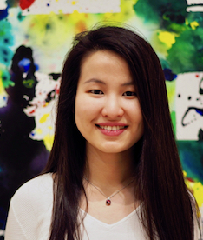
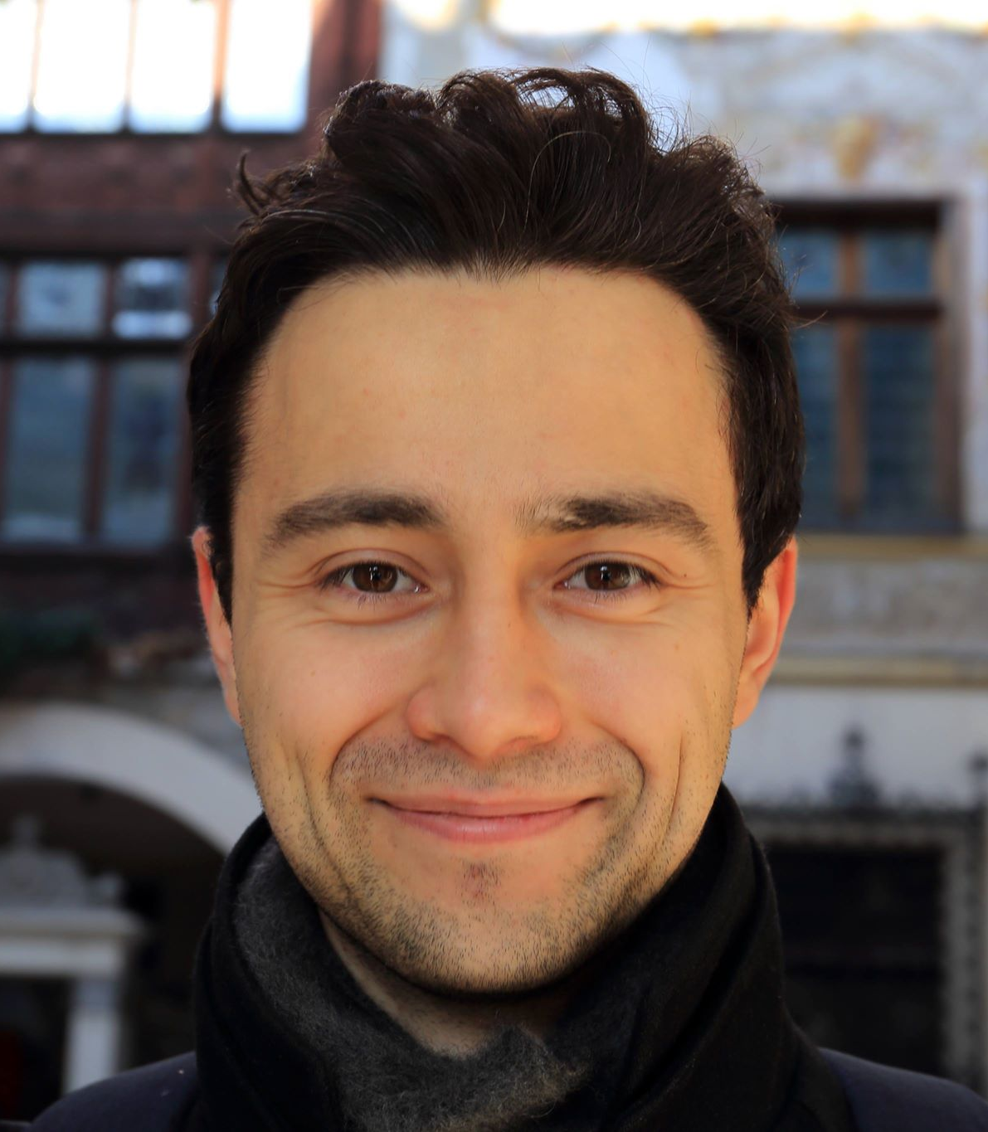
Competing Bandits in Matching Markets
Lydia Liu
Horia Mania

Slide 15



Multi-Armed Bandits
MABs offer a natural platform to understand exploration / exploitation trade-offs
1
2
3.

Slide 16
Upper Confidence Bound (UCB) Algorithm
Maintain an upper confidence bound on reward values
Pick the arm with the largest upper confidence bound
1
2
3.

Slide 17
Upper Confidence Bound (UCB) Algorithm
Maintain an upper confidence bound on reward values
Pick the arm with the largest upper confidence bound
1
2
3.

Slide 18
Upper Confidence Bound (UCB) Algorithm
Maintain an upper confidence bound on reward values
Pick the arm with the largest upper confidence bound
1
2
3.

Slide 19
Matching Markets
Suppose we have a market in which the participants have preferences:
Buyers / Demand
Sellers / Supply
1 > 3 > 2
1 > 2 > 3
2 > 3 > 1
3 > 1 > 2
1 > 2 > 3
2 > 1 > 3
Gale and Shapley introduced this problem in 1962 and proposed a celebrated algorithm that always finds a stable match

Slide 20
Matching Markets Meet Bandit Learning
What if the participants in the market do not know their preferences a priori, but observe noisy utilities through repeated interactions?
Now the participants have an exploration/exploitation problem, in the context of other participants

Slide 21

Competing Agents
0
1.
2.
3.

Slide 22
Bandit Markets
We conceive of a bandit market: agents on one side, arms on the other side.
Agents get noisy rewards when they pull arms.
Arms have preferences over agents (these preferences can also express agents’ skill levels)
When multiple agents pull the same arm only the most preferred agent gets a reward.

Slide 23
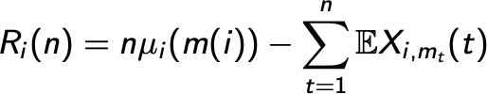
Regret in Bandit Markets
Then it is natural to define the regret of agent i up to time n as:
Mean reward of stable match
Reward at time t
Minimizing this regret is natural. It says that agents should expect rewards as good as their stable match in hindsight.

Slide 24
Regret-Minimizing Algorithm
Gale-Shapley upper confidence bounds (GS-UCB):
Agents rank arms according to upper confidence bounds for the mean rewards.
Agents submit rankings to a matching platform.
The platform uses these rankings to run the Gale-Shapley algorithm to match agents and arms.
Agents receive rewards and update upper confidence bounds.
Repeat.

Slide 25

Theorem
Theorem (informal): If there are N agents and K arms and GS-UCB is run, the regret of agent i satisfies
Reward gap of possibly other agents.
In other words, if the bear decides to explore more, the human might have higher regret.
See paper for refinements of this bound and further discussion of exploration-exploitation trade-offs in this setting.
Finally, we note that GS-UCB is incentive compatible. No single agent has an incentive to deviate from the method.

Slide 26
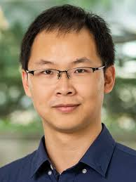
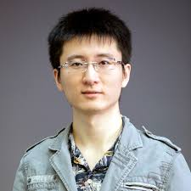
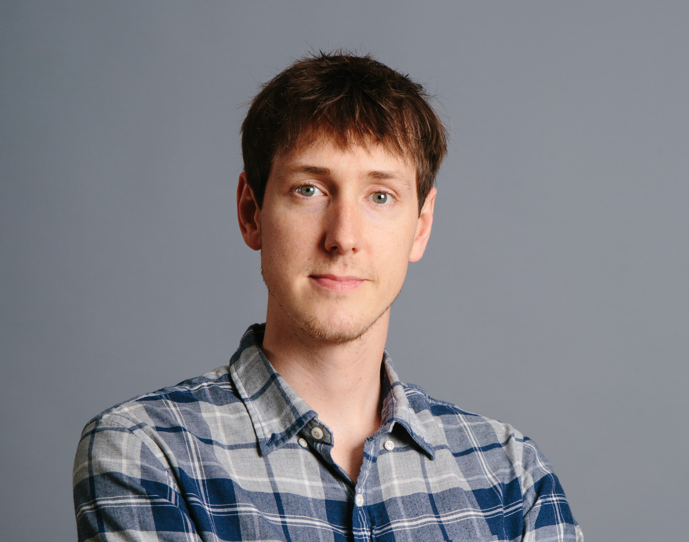
UCB Meets Reinforcement Learning (aka, Is Q-Learning Provably Efficient?)
Chi Jin
Zeyuan Allen-Zhu
Sebastien Bubeck

Slide 27
Reinforcement Learning

Slide 28
Model-Based vs. Model-Free RL

Slide 29
Q-Learning with UCB

Slide 30
State of the Theory

Slide 31


Asynchronous, Online, Continuous Decision-Making
Tijana Zrnic
Aaditya Ramdas

Slide 32
Making Decisions Over a Lifetime
Think of statistical bounds on error rates in decision-making as a form of wealth
Classical bounds: wealth decays as you make more decisions
  e.g., Bonferroni corrections
Eventually you have to stop making decisions

Slide 33
Making Decisions Over a Lifetime
Think of statistical bounds on error rates in decision-making as a form of wealth
Classical bounds: wealth decays as you make more decisions
  e.g., Bonferroni corrections
Eventually you have to stop making decisions
Is it possible to continue to make decisions throughout one’s lifetime and maintain (anytime) control over the statistical error rate?

Slide 34
Making Decisions Over a Lifetime (Cont)
We need to consider “error rates” that have an economic interpretation
“False discovery rates” have emerged in statistics for other reasons, but they

Slide 35



True nulls
Non-Nulls
P1
P7
P4
P5
P6
false discoveries
discoveries
P9
P8
P2
P3
False discovery proportion
Want low false discovery rate

Slide 36
type-1 error rate (per test) = 0.05
Run 10,000
different,
independent
A/B tests
9,900 true
nulls
495 false discoveries
“false discovery
proportion”
FDP = 495/575
100 non-nulls
80 true discoveries
power (per test) = 0.80

Slide 37
Classical FDR Control
The Benjamini-Hochberg procedure controls the FDR for a batch of multiple decisions
It involves sorting the p-values for the decisions
It is therefore not an online, anytime procedure

Slide 38
SAFFRON
A new methodology that allows a decision-maker to maintain control over the FDR on an anytime basis
The basic idea: the FDP is a ratio, and it can be made small either by making the numerator small (few false positives) or by making the denominator large (many discoveries)
  we give a controlled amount of wealth to a decision-maker whenever they make a discovery, to be invested in future decisions
The approach can handle fully asynchronous decisions across groups of decision makers

Slide 39
Online FDR control : high-level picture
Error budget for first test
Error budget for second test
Tests use wealth
Discoveries earn wealth
Error budget
is data-dependent
Remaining error budget
or “alpha-wealth”
Infinite process

Slide 40
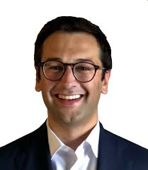
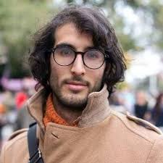
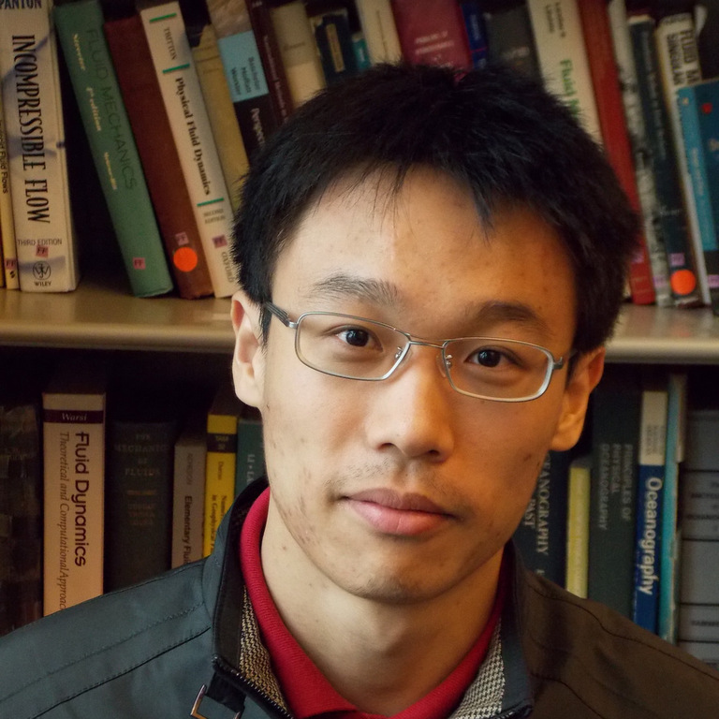
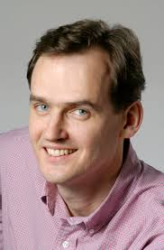
Langevin Bandits
with Eric Mazumdar, Aldo Pacchiano, Yi-An Ma and Peter Bartlett

Slide 41
Two Approaches to Multi-Armed Bandits
Bayesian Approach ("model based”)
Frequentist Approach ("model free”)
Thompson Sampling (Thompson, 1933)
Trade off exploration/exploitation by choosing the arm with the highest sample from the posterior.
Incurs logarithmic regret with flat priors and gaussian rewards or beta priors with Bernoulli rewards, or exponential families with flat priors.
Can use prior information.
Upper Confidence Bound (UCB) algorithm
(Lai and Robbins, 1985)
Trade off exploration/exploitation by choosing the arm with the highest upper confidence bound:
Incurs logarithmic regret on 1-subgaussian bandits.
  Matches the instance-dependent lower bounds
Cannot use prior information.

Slide 42
Two Approaches to Multi-Armed Bandits
Bayesian Approach ("model based”)
Frequentist Approach ("model free”)
Thompson Sampling
Thompson (1933)
Trade off exploration/exploitation by choosing the arm with the highest sample from the posterior.
Incurs logarithmic regret with flat priors and gaussian rewards or beta priors with Bernoulli rewards, or 1-D exponential families with flat priors.
Can use prior information.
Upper Confidence Bound (UCB) algorithm
Lai and Robbins (1985)
Trade off exploration/exploitation by choosing the arm with the highest upper confidence bound:
Incurs logarithmic regret on 1-subgaussian bandits.
  Matches the instance-dependent lower bounds
Cannot use prior information.
Thompson sampling is in general not well understood in general because:
  Posteriors are not well characterized outside of conjugate families.
  Sampling from arbitrary posteriors is hard and recent work [1] suggests that naively using approximate samples can incur linear regret.

Slide 43
Two Approaches to Multi-Armed Bandits
Bayesian Approach ("model based”)
Frequentist Approach ("model free”)
Thompson Sampling
Thompson (1933)
Trade off exploration/exploitation by choosing the arm with the highest sample from the posterior.
Incurs logarithmic regret with flat priors and gaussian rewards or beta priors with Bernoulli rewards, or 1-D exponential families with flat priors.
Can use prior information.
Upper Confidence Bound (UCB) algorithm
Lai and Robbins (1985)
Trade off exploration/exploitation by choosing the arm with the highest upper confidence bound:
Incurs logarithmic regret on 1-subgaussian bandits.
  Matches the instance-dependent lower bounds
Cannot use prior information.
Thompson sampling is in general not well understood in general because:
  Posteriors are not well characterized outside of conjugate families.
    Derive novel posterior contraction rates for strongly log-concave distributions.
  Sampling from arbitrary posteriors is hard and recent work [1] suggests that naively using approximate samples can incur linear regret.
    We show that it is possible to use approximate samples from Stochastic Gradient Langevin MCMC and maintain order-optimal regret with a constant amount of computation per iteration.

Slide 44
Posterior Contraction Rates
We assume that:
1. The likelihood family of the mean of each arm is strongly log-concave and sufficiently smooth:
  The prior over the mean of each arm is log-concave and sufficiently smooth:
We show that after arm a has been pulled n times, the posterior distribution for the mean satisfies the following high probability concentration around the true mean:
Depends on log-concavity and smoothness parameters
prior dependence

Slide 45
Posterior Contraction Rates
We assume that:
1. The likelihood family of the mean of each arm is strongly log-concave and sufficiently smooth:
  The prior over the mean of each arm is log-concave and sufficiently smooth:
  The prior over the mean of each arm is log-concave and sufficiently smooth:
We show that after arm a has been pulled n times, the posterior distribution on the mean satisfies the following high probability concentration around the true mean:
Depends on log-concavity and smoothness parameters
prior dependence
Analyze the stochastic differential equation:
Posterior distribution

Slide 46
Stochastic Gradient Langevin MCMC
Even though we understand how the posterior concentrates around the true mean, sampling from the posterior is not straightforwards
Idea: Use stochastic gradient Langevin MCMC to generate samples from approximations to the posterior and bound the approximation error.
Computationally efficient!
  Na and Ka are constants depending only on smoothness and concavity parameters.
  ha,n is O(1/n).
At a round t, and given n samples Xa,1,…,X a,n from arm a, and the previous sample from the arm :
  Set
  For Na rounds:
    Sample without replacement a batch of size Ka of the data.
    Compute the stochastic gradient:
    Update with step-size ha,n:

Slide 47
Regret of Approximate Thompson sampling with Langevin
To prove the logarithmic regret bound we define:
Without loss of generality let arm 1 be the optimal arm and define $Δ_{a}=μ_{1}^{∗}−μ_{a}^{∗}$
Using the posterior concentration bound, and by bounding the approximation error of the stochastic gradient Langevin MCMC algorithm we show that Thompson Sampling enjoys the regret bound:
Optimal rate
(up to constant factors)
Probability the prior of the optimal arm is ‘optimistic’

Slide 48
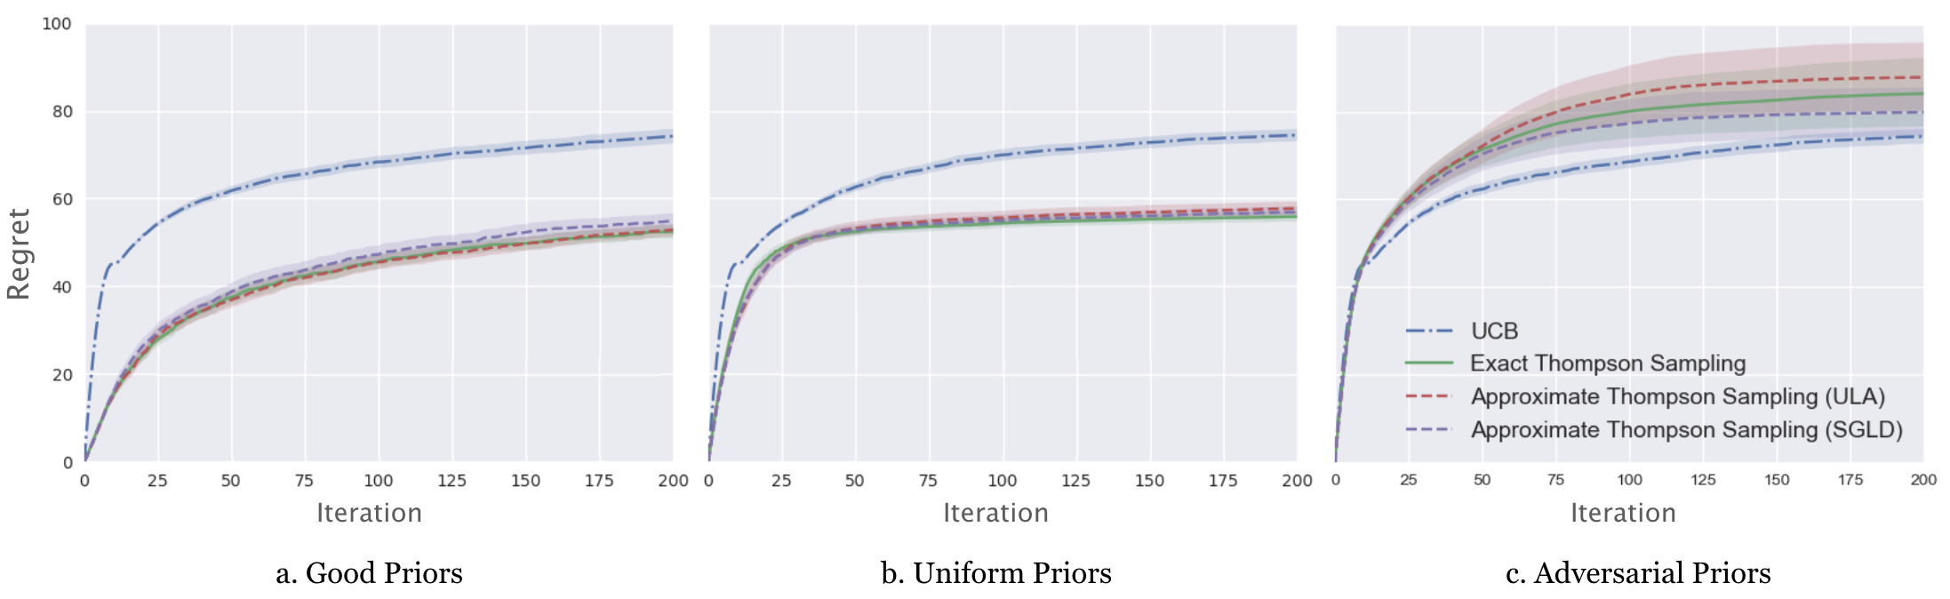
Empirical Results
We empirically validate that the approximate Thompson sampling algorithm maintains the advantages of Thompson sampling over UCB on a 10-armed Gaussian bandit with means at 1,2,…,10 and variance 1.
Priors reflect the correct orderings of the arms’ means.
Priors are the same across arms.
Priors reflect the opposite orderings of the arms’ means.

Slide 49
Ray: A Distributed Platform for Emerging Decision- and Market-Focused ML Systems
with P Moritz, R Nishihara, S Wang, A Tumanov, R Liaw, E Liang, and I Stoica

Slide 50
What is Ray?
Machine Learning Ecosystem
Distributed Training
Model Serving
Streaming
Distributed RL
Data Processing
Hyperparameter Search

Slide 51
What is Ray?
Machine Learning Ecosystem
Distributed
System
Distributed System
Distributed System
Distributed System
Distributed System
Distributed System
Distributed Training
Model Serving
Streaming
Distributed RL
Data Processing
Hyperparameter Search
Horovod, Distributed TF, Parameter Server
Clipper, TensorFlow Serving
Flink, many others
Baselines, RLlab, ELF, Coach, TensorForce, ChainerRL
MapReduce, Hadoop, Spark
Many internal systems at companies

Slide 52
What is Ray?
Machine Learning Ecosystem
Distributed System (Ray)
Libraries
Distributed Training
Model Serving
Streaming
Distributed RL
Data Processing
Hyperparameter Search

Slide 53
Programming Languages
What do modern languages such as Python provide?
Functions
Objects

Slide 54
Programming Languages
What do modern languages such as Python provide?
Functions
Objects
What is the focus of distributed frameworks such as Hadoop and Spark?
Functions

Slide 55
Ray as a Language for Distributed Computing
What does Ray provide?
Distributed functions (“tasks”)
Distributed objects (“actors”)

Slide 56
Ray as a Language for Distributed Computing
What does Ray provide?
Distributed functions (“tasks”)
Distributed objects (“actors”)
The distributed implementation is provided by the Ray system, with the user not needing to know anything about the details of the implementation

Slide 57
Single-Threaded Hyperparameter Search
from collections import defaultdict
import numpy as np
import tensorflow as tf
from tensorflow.examples.tutorials.mnist import input_data
def train_cnn_and_compute_accuracy(params, steps, train_images, train_labels,
validation_images, validation_labels,
weights=None):
# Extract the hyperparameters from the params dictionary.
learning_rate = params["learning_rate"]
batch_size = params["batch_size"]
keep = 1 - params["dropout"]
stddev = params["stddev"]
# Create the network and related variables.
with tf.Graph().as_default():
# Create the input placeholders for the network.
x = tf.placeholder(tf.float32, shape=[None, 784])
y = tf.placeholder(tf.float32, shape=[None, 10])
keep_prob = tf.placeholder(tf.float32)
# Create the network.
train_step, accuracy, loss = cnn_setup(x, y, keep_prob, learning_rate,
stddev)
# Do the training and evaluation.
with tf.Session() as sess:
sess.run(tf.global_variables_initializer())
if weights is not None:
variables.set_weights(weights)
# Do some steps of training.
for i in range(1, steps + 1):
image_batch = get_batch(train_images, i, batch_size)
label_batch = get_batch(train_labels, i, batch_size)
sess.run(train_step, feed_dict={x: image_batch, y: label_batch,
keep_prob: keep})
totalacc = accuracy.eval(feed_dict={x: validation_images,
y: validation_labels,
keep_prob: 1.0})
new_weights = variables.get_weights()
return float(totalacc), new_weights
steps = 20
mnist = input_data.read_data_sets("MNIST_data", one_hot=True)
train_images = mnist.train.images
train_labels = mnist.train.labels
validation_images = mnist.validation.images
validation_labels = mnist.validation.labels
accuracies_by_num_steps = defaultdict(lambda: [])
# Define a method to determine if an experiment looks promising or not.
def is_promising(experiment_info):
accuracies = experiment_info["accuracies"]
total_num_steps = experiment_info["total_num_steps"]
comparable_accuracies = accuracies_by_num_steps[total_num_steps]
if len(comparable_accuracies) == 0:
if len(accuracies) == 1:
return True
else:
return (np.mean(accuracies[:len(accuracies) // 2]) <
np.mean(accuracies[len(accuracies) // 2:]))
return np.mean(accuracy > np.array(comparable_accuracies)) > 0.5
experiment_info = {}
remaining_vals = []
# Keep track of the best hyperparameters and the best accuracy.
best_hyperparameters = None
best_accuracy = 0
# A function for generating random hyperparameters.
def generate_hyperparameters():
return {"learning_rate": 10 ** np.random.uniform(-5, 5),
"batch_size": np.random.randint(1, 100),
"dropout": np.random.uniform(0, 1),
"stddev": 10 ** np.random.uniform(-5, 5)}
for _ in range(5):
hyperparameters = generate_hyperparameters()
experiment_val = train_cnn_and_compute_accuracy (
hyperparameters, steps, train_images, train_labels,
validation_images, validation_labels)
experiment_info[experiment_val] = {"hyperparameters": hyperparameters,
"total_num_steps": steps,
"accuracies": []}
remaining_vals.append(experiment_val)
for _ in range(10):
ready_vals, remaining_vals = remaining_vals[0], remaining_vals[1:]
experiment_val = ready_vals[0]
accuracy, weights = experiment_val)
previous_info = experiment_info[experiment_val]
previous_info["accuracies"].append(accuracy)
if accuracy > best_accuracy:
best_hyperparameters = previous_info["hyperparameters"]
best_accuracy = accuracy
if is_promising(previous_info):
# If the experiment does not look promising, start a new
# experiment.
print("Ending the experiment with hyperparameters {}."
.format(previous_info["hyperparameters"]))
new_hyperparameters = previous_info["hyperparameters"]
new_info = {"hyperparameters": new_hyperparameters,
"total_num_steps": (previous_info["total_num_steps"] +
steps),
"accuracies": previous_info["accuracies"][:]}
starting_weights = weights
else:
new_hyperparameters = generate_hyperparameters()
new_info = {"hyperparameters": new_hyperparameters,
"total_num_steps": steps, "accuracies": []}
starting_weights = None
new_experiment_val = train_cnn_and_compute_accuracy.(
new_hyperparameters, steps, train_images, train_labels,
validation_images, validation_labels, weights=starting_weights)
experiment_info[new_experiment_val] = new_info
remaining_vals.append(new_experiment_val)
accuracies_by_num_steps[previous_info["total_num_steps"]].append(accuracy)

Slide 58
Distributed With Ray
from collections import defaultdict
import numpy as np
import ray
import tensorflow as tf
from tensorflow.examples.tutorials.mnist import input_data
@ray.remote
def train_cnn_and_compute_accuracy(params, steps, train_images, train_labels,
validation_images, validation_labels,
weights=None):
# Extract the hyperparameters from the params dictionary.
learning_rate = params["learning_rate"]
batch_size = params["batch_size"]
keep = 1 - params["dropout"]
stddev = params["stddev"]
# Create the network and related variables.
with tf.Graph().as_default():
# Create the input placeholders for the network.
x = tf.placeholder(tf.float32, shape=[None, 784])
y = tf.placeholder(tf.float32, shape=[None, 10])
keep_prob = tf.placeholder(tf.float32)
# Create the network.
train_step, accuracy, loss = cnn_setup(x, y, keep_prob, learning_rate,
stddev)
# Do the training and evaluation.
with tf.Session() as sess:
sess.run(tf.global_variables_initializer())
if weights is not None:
variables.set_weights(weights)
# Do some steps of training.
for i in range(1, steps + 1):
image_batch = get_batch(train_images, i, batch_size)
label_batch = get_batch(train_labels, i, batch_size)
sess.run(train_step, feed_dict={x: image_batch, y: label_batch,
keep_prob: keep})
totalacc = accuracy.eval(feed_dict={x: validation_images,
y: validation_labels,
keep_prob: 1.0})
new_weights = variables.get_weights()
return float(totalacc), new_weights
ray.init()
steps = 20
mnist = input_data.read_data_sets("MNIST_data", one_hot=True)
train_images = mnist.train.images
train_labels = mnist.train.labels
validation_images = mnist.validation.images
validation_labels = mnist.validation.labels
accuracies_by_num_steps = defaultdict(lambda: [])
# Define a method to determine if an experiment looks promising or not.
def is_promising(experiment_info):
accuracies = experiment_info["accuracies"]
total_num_steps = experiment_info["total_num_steps"]
comparable_accuracies = accuracies_by_num_steps[total_num_steps]
if len(comparable_accuracies) == 0:
if len(accuracies) == 1:
return True
else:
return (np.mean(accuracies[:len(accuracies) // 2]) <
np.mean(accuracies[len(accuracies) // 2:]))
return np.mean(accuracy > np.array(comparable_accuracies)) > 0.5
experiment_info = {}
remaining_vals = []
# Keep track of the best hyperparameters and the best accuracy.
best_hyperparameters = None
best_accuracy = 0
# A function for generating random hyperparameters.
def generate_hyperparameters():
return {"learning_rate": 10 ** np.random.uniform(-5, 5),
"batch_size": np.random.randint(1, 100),
"dropout": np.random.uniform(0, 1),
"stddev": 10 ** np.random.uniform(-5, 5)}
for _ in range(5):
hyperparameters = generate_hyperparameters()
experiment_val = train_cnn_and_compute_accuracy.remote(
hyperparameters, steps, train_images, train_labels,
validation_images, validation_labels)
experiment_info[experiment_val] = {"hyperparameters": hyperparameters,
"total_num_steps": steps,
"accuracies": []}
remaining_vals.append(experiment_val)
for _ in range(10):
ready_vals, remaining_vals = ray.wait(remaining_vals)
experiment_val = ready_vals[0]
accuracy, weights = ray.get(experiment_val)
previous_info = experiment_info[experiment_val]
previous_info["accuracies"].append(accuracy)
if accuracy > best_accuracy:
best_hyperparameters = previous_info["hyperparameters"]
best_accuracy = accuracy
if is_promising(previous_info):
# If the experiment does not look promising, start a new
# experiment.
print("Ending the experiment with hyperparameters {}."
.format(previous_info["hyperparameters"]))
new_hyperparameters = previous_info["hyperparameters"]
new_info = {"hyperparameters": new_hyperparameters,
"total_num_steps": (previous_info["total_num_steps"] +
steps),
"accuracies": previous_info["accuracies"][:]}
starting_weights = weights
else:
new_hyperparameters = generate_hyperparameters()
new_info = {"hyperparameters": new_hyperparameters,
"total_num_steps": steps, "accuracies": []}
starting_weights = None
new_experiment_val = train_cnn_and_compute_accuracy.remote(
new_hyperparameters, steps, train_images, train_labels,
validation_images, validation_labels, weights=starting_weights)
experiment_info[new_experiment_val] = new_info
remaining_vals.append(new_experiment_val)
accuracies_by_num_steps[previous_info["total_num_steps"]].append(accuracy)

Slide 59
Broad Range of Scalable Algorithms
High-throughput architectures
  Distributed Prioritized Experience Replay (Ape-X)
  Importance Weighted Actor-Learner Architecture (IMPALA)
  Asynchronous Proximal Policy Optimization (APPO)
Gradient-based
  Soft Actor-Critic (SAC)
  Advantage Actor-Critic (A2C, A3C)
  Deep Deterministic Policy Gradients (DDPG, TD3)
  Deep Q Networks (DQN, Rainbow, Parametric DQN)
  Policy Gradients
  Proximal Policy Optimization (PPO)
Derivative-free
  Augmented Random Search (ARS)
  Evolution Strategies
Multi-agent specific
  QMIX Monotonic Value Factorisation (QMIX, VDN, IQN)
Offline
  Advantage Re-Weighted Imitation Learning (MARWIL)
Notes:
Rllib has large and growing number of algorithms. Many of these algorithms are community contributions, for example from different UC Berkeley groups and Alibaba.

Slide 60
Ray Architecture
Driver
Worker
Worker
Worker
Worker
Worker
Object Store
Object Store
Object Store
Raylet
Raylet
Raylet
Object Manager
Object Manager
Object Manager
Scheduler
Scheduler
Scheduler
Global Control Store
Debugging Tools
Global Control Store
Global Control Store
Profiling Tools
Web UI

Slide 61












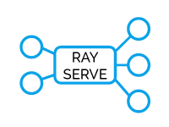












Growing Library Ecosystem
3rd Party Libraries
Native Libraries
ModelArts
universal framework for distributed computing

Slide 62
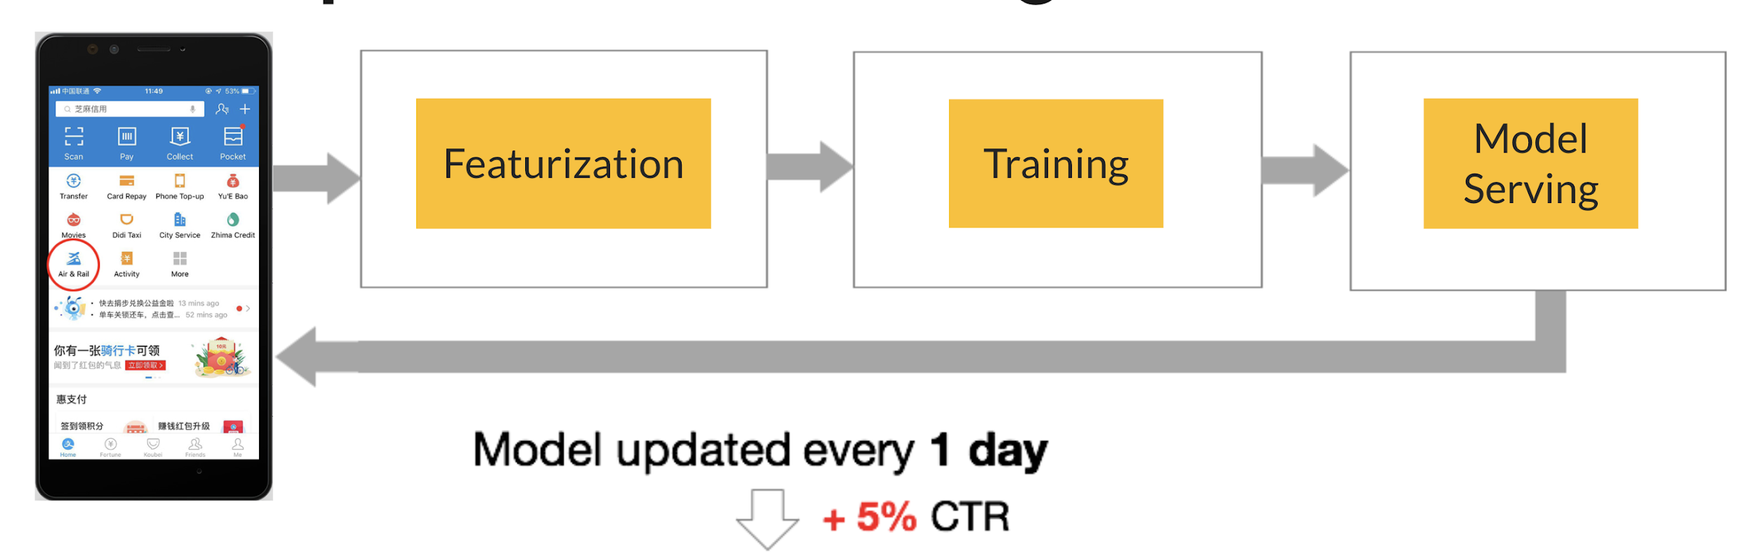
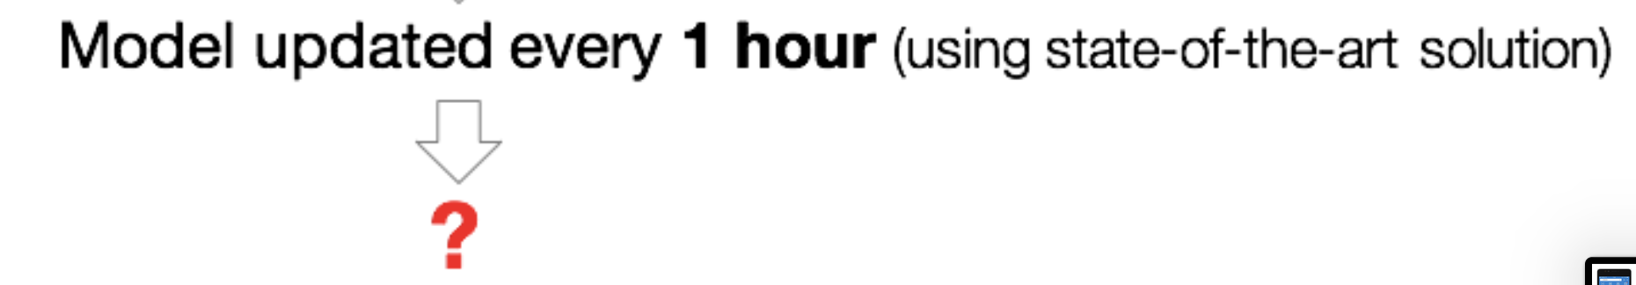
Example: Online Learning

Slide 63
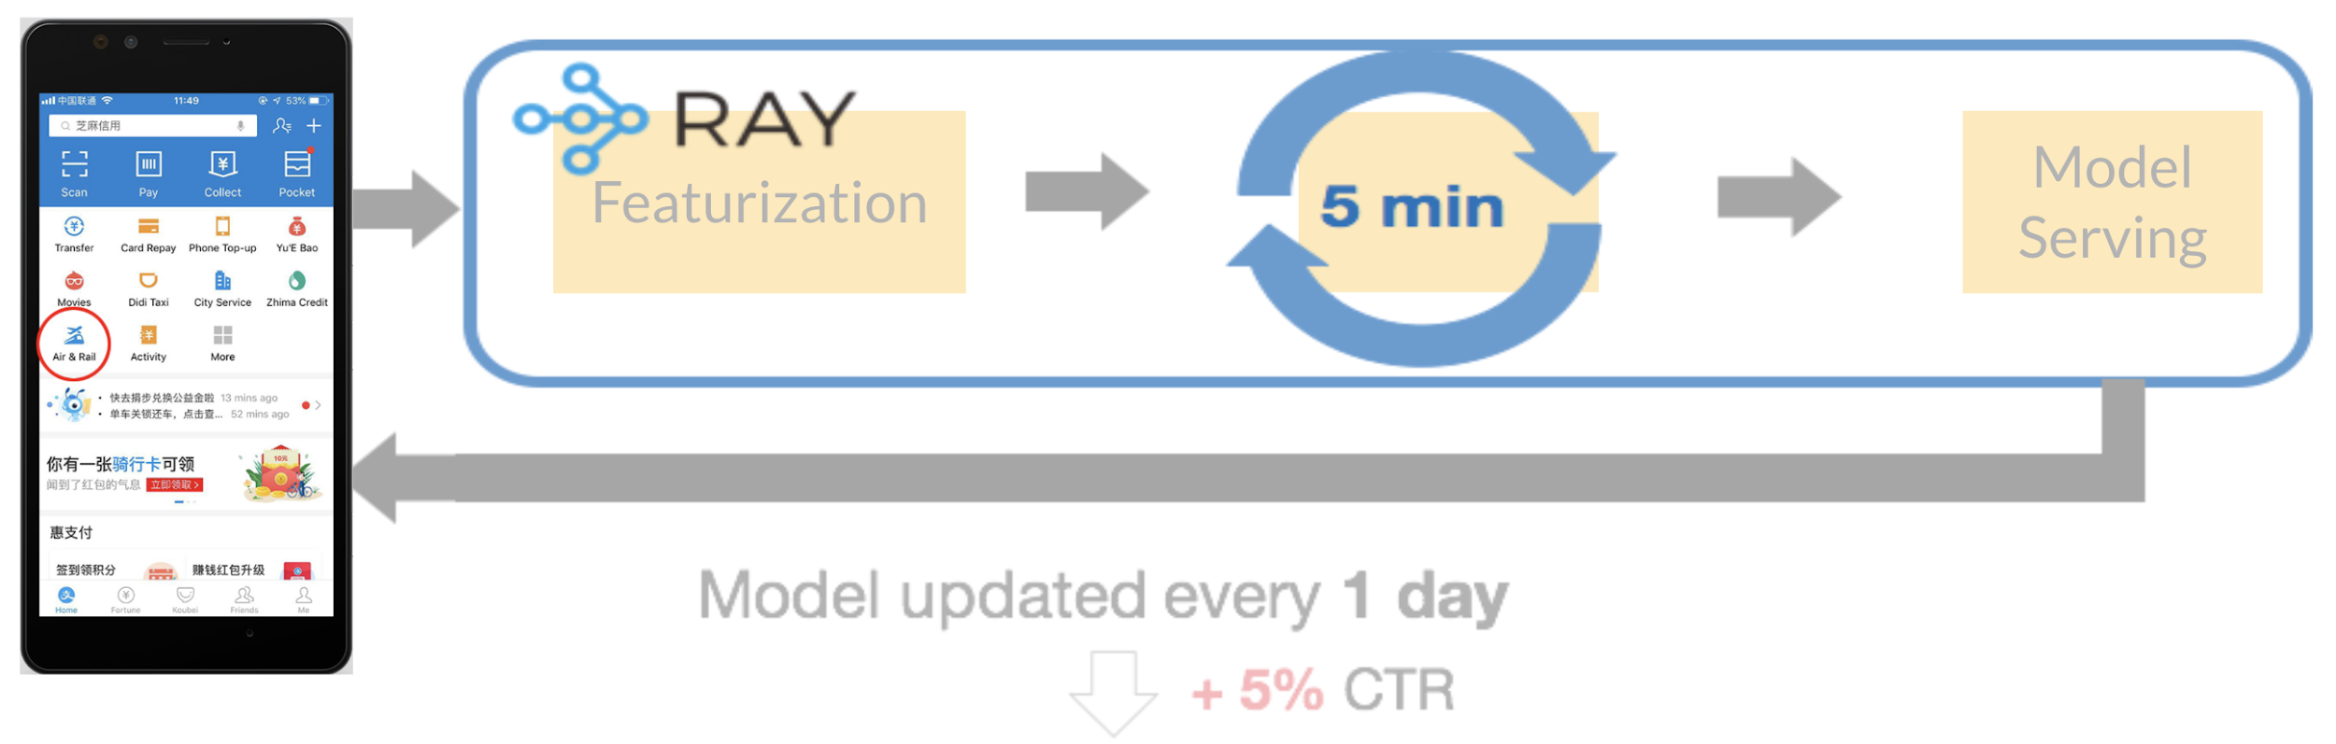
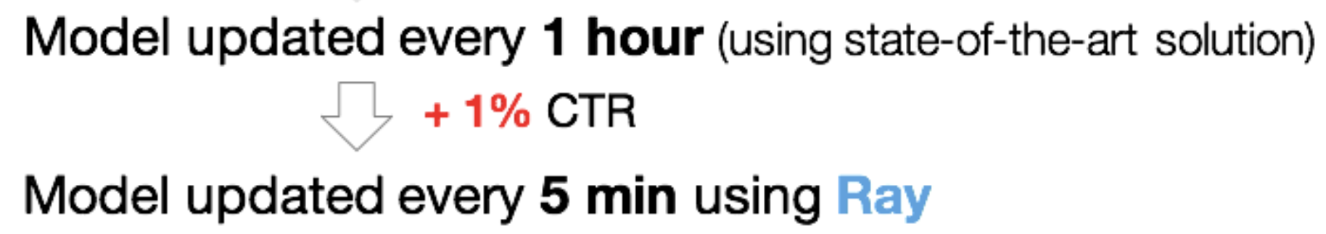
Example: Online Learning

Slide 64
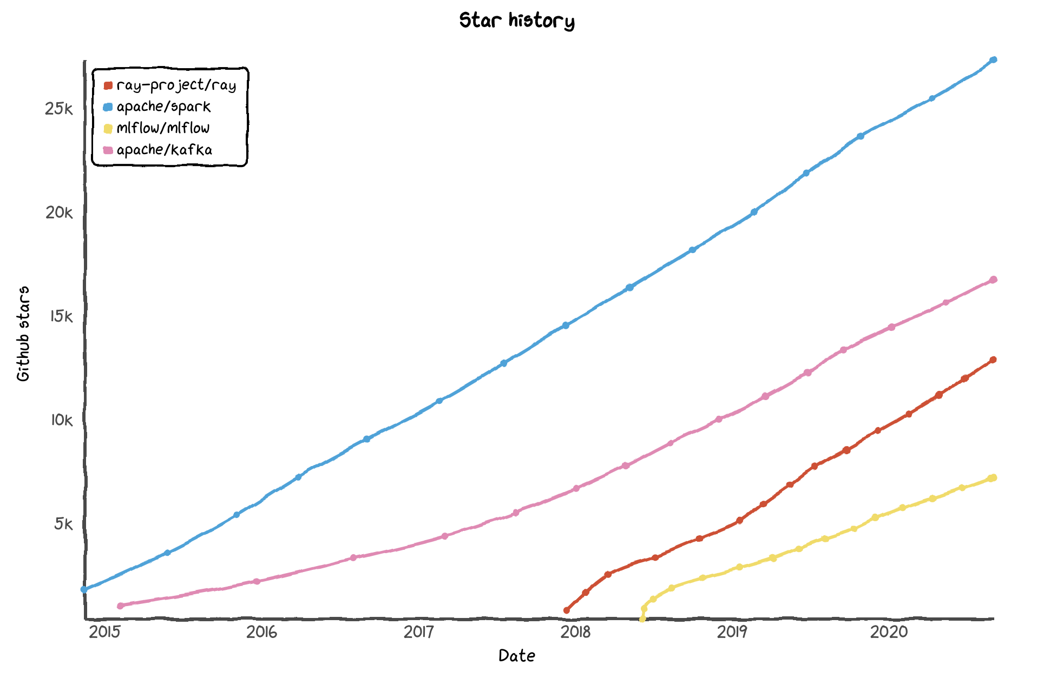
Spark
Matches Spark’s growth!
Kafka
Ray
MLFlow
Notes:
In fact, if you put this in the context of other successful open source projects, you’ll see that the growth for Ray today, identically matches that of Spark and exceeds other projects like Kafka.

Slide 65
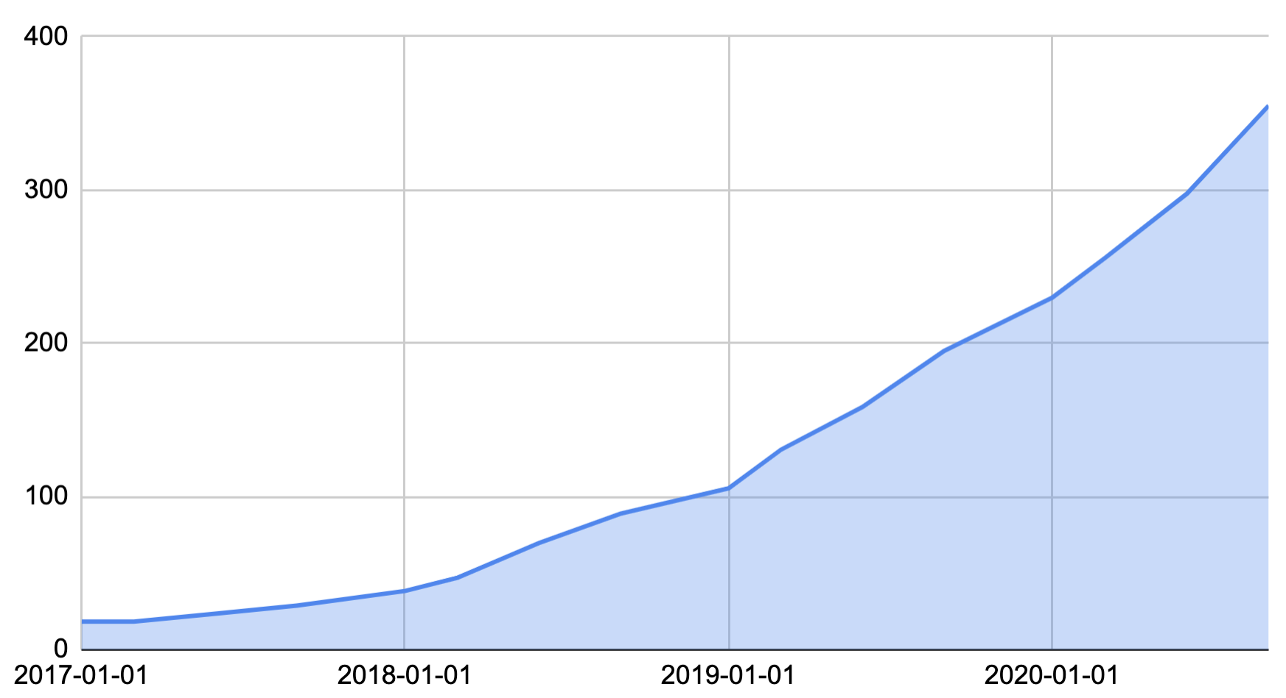
Adoption: Contributors
360 (September, 2020)

Slide 66

















100+ companies using Ray

Slide 67
Conclusions
Ray is a system for distributed Python
  includes libraries targeting AI applications
Open source at github.com/ray-project/ray
Install with pip install ray
Reference: Moritz, P., Nishihara, R., Wang, S., Tumanov, A., Liaw, R., Liang, E., Jordan, M. I., & Stoica, I. (2018). A distributed framework for emerging AI applications. In 13th USENIX Symposium on Operating Systems Design and Implementation (OSDI).

Slide 68
Parting Comments
The current era of machine learning has focused on pattern recognition
  platforms such as TensorFlow and PyTorch have arisen to help turn pattern recognition into a commodity
The decision-making side of machine learning will be a focus in the future
  individual high-stake decisions
  explanations for decisions, and dialog about decisions
  sequences of decisions
  multiple simultaneous decisions
  decisions in the context of multiple decision-makers
  market mechanisms

